Slide 1
Theme: Open Innovation
Topic: Cybersecurity Awareness Gamification
Team: Clueless Coders
Team members:
Deepika.P
Kruthika Eleswarapu

Slide 2
Problem Statement:
In today's digital world, the lack of cybersecurity awareness leaves users vulnerable to threats.
We aim to develop an innovative and engaging gamified platform that educates users about cybersecurity, empowering them to protect their data and privacy.

Slide 3
Problem Description:
Cyber threats are endangering individuals and organizations and most users lack the knowledge and skills to defend against these threats.
Conventional cybersecurity training fail to educate effectively. Our challenge is to create a platform that imparts cybersecurity wisdom in an interactive and entertaining manner.

Slide 4
Idea/Approach to the Problem:
Our strategy is to craft a gamified cybersecurity awareness platform.
Users will immerse themselves in interactive challenges, lifelike simulations, and brain-teasing quizzes. To take it a step further, our platform will offer real-world incentives and certifications.

Slide 5
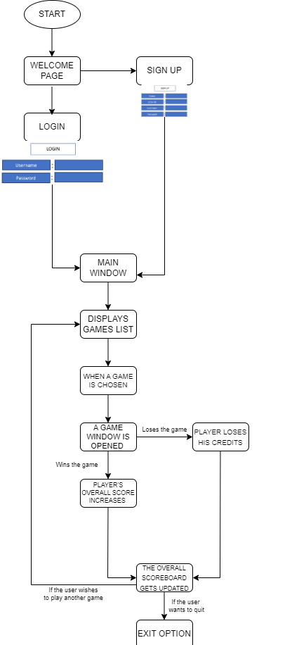
Workflow :

Slide 6
Various Games which are included:
Cyber Smarts Challenge (Cybersecurity Trivia)
Incident Commander (Incident Response Simulation)
Risk Sentinel (Risk Assessment)
Security Savvy Showdown (Security Awareness Challenges)
Guardian of Cyberworld (Security Simulation)
Incident Response Mastery (Handling Security Incidents)
Password Fortify (Password Strength Checker)

Slide 7


Slide 8


Slide 9

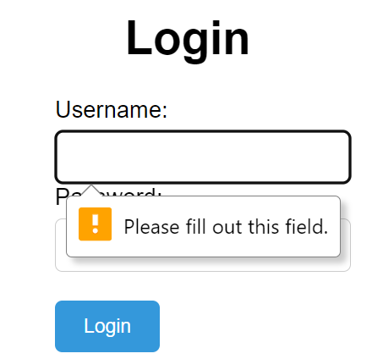
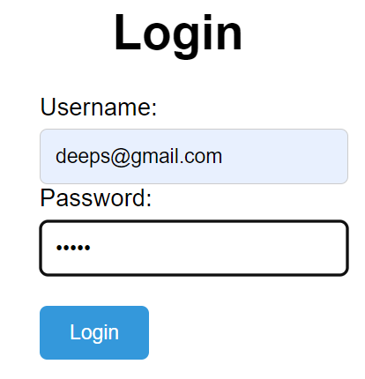

Slide 10
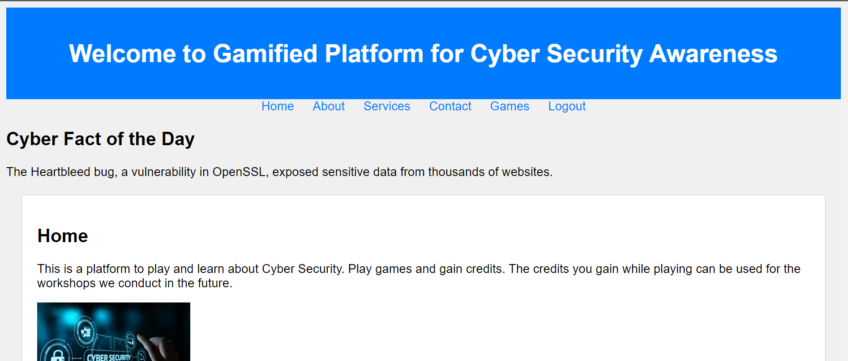


Slide 11
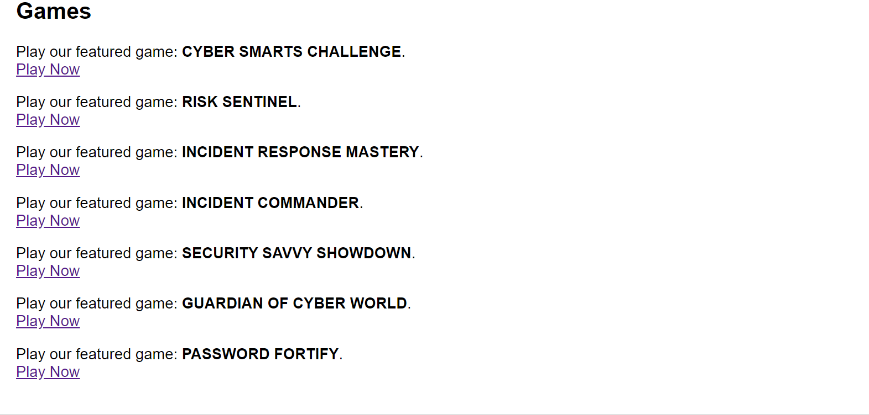


Slide 12


Slide 13
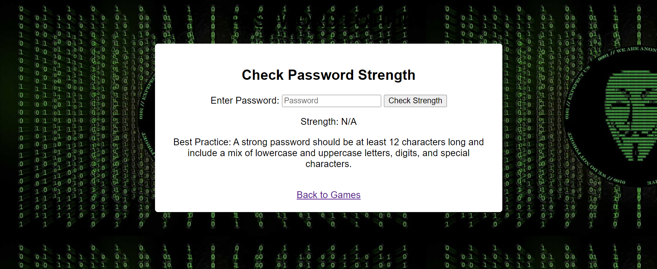

Slide 15
Methodology:
Security: Fortify our platform's defenses, ensuring it stands strong against cyber threats.
Launch and Promotion: Roll out our creation with a strategic marketing campaign that sparks user interest.
Continuous Improvement: Responsively adapt and enrich content and features based on user feedback.

Slide 16
Challenges:
User Engagement: Keep users hooked and entertained over time.
Content Quality: Deliver up-to-the-minute, reliable, and engaging cybersecurity content.
Security: Safeguard user data and our platform against ever-evolving cyber threats by implementing the new cyber security techniques.

Slide 17
Challenges:
Scalability: Seamlessly handle a burgeoning user base and a rapidly expanding content library.
User Privacy: Strictly adhere to privacy regulations, ensuring top-tier data protection.
Promotion: Outshine competitors to attract and retain a dedicated user base.

Slide 18
Dependencies:
Content Development: Forge partnerships with cybersecurity experts to guarantee cutting-edge content.
User Feedback: Continuously solicit and integrate user feedback, guiding our platform's evolution.
Marketing Team: Collaborate closely with a dynamic marketing team for optimal promotion and user acquisition.
Cybersecurity Tools: Leverage essential cybersecurity tools and services to fortify our platform's defenses.

